Slide 1

Salary Predictions of Data Professions
Welcome to the Machine Learning Internship, focused on predicting the salaries of data professionals. This project will delve into the world of regression tasks, providing hands-on experience in data analysis, feature engineering, and machine learning model development. Our mission is to build a predictive model for salaries of data professionals, uncovering insights that can benefit both job seekers and employers.
by Divya Vaishnavi V

Slide 2
Introduction
In today's competitive business environment, attracting and retaining top talent is crucial for organizational success. One of the key factors influencing employee satisfaction and retention is fair and competitive compensation. However, determining appropriate salary levels can be a complex task, involving the consideration of multiple factors such as experience, performance, and market trends.
The Salary Prediction Project addresses this challenge by utilizing advanced machine learning techniques to predict employee salaries. By analyzing historical employee data, the application identifies patterns and relationships between various features and salary outcomes. This allows HR departments to make data-informed decisions, ensuring that salaries are aligned with employee contributions and market standards.

Slide 3
Project Objective: Predicting Data Professional Salaries
1
Problem Statement
2
Mission
Salaries in the field of data professions exhibit wide variations based on factors like experience, job role, and performance. Accurately predicting salaries for these professionals is crucial for both job seekers and employers.
Our mission is to construct a predictive model for salaries of data professionals. You'll explore the dataset, conduct comprehensive data analysis, and develop a machine learning model capable of predicting salaries.
3
Key Steps
4
Impact
The project involves several key steps, including exploratory data analysis (EDA), feature engineering, data preprocessing, model development, evaluation, and deployment.
The insights gained from this project can be used to inform hiring decisions, salary negotiations, and career planning for data professionals.

Slide 4
Exploratory Data Analysis (EDA): Unveiling Salary Trends
Data Exploration
Data Visualization
Insights
We will start by diving deep into the dataset. This involves exploring data distributions, identifying outliers, and understanding relationships between variables.
Analyze distributions of key variables like salary, age, and experience.
Identify any potential outliers that may skew results.
Identify any potential outliers that may skew results.
Visualization is essential for gaining insights from the data. We will create various types of charts and graphs to visualize patterns and trends.
Histograms to understand distributions of numerical variables.
Scatter plots to explore relationships between variables.
Box plots to compare distributions across groups.
EDA will provide valuable insights into the factors influencing salaries, such as experience levels, job roles, and performance ratings. These insights will guide your feature engineering and model selection decisions.

Slide 5
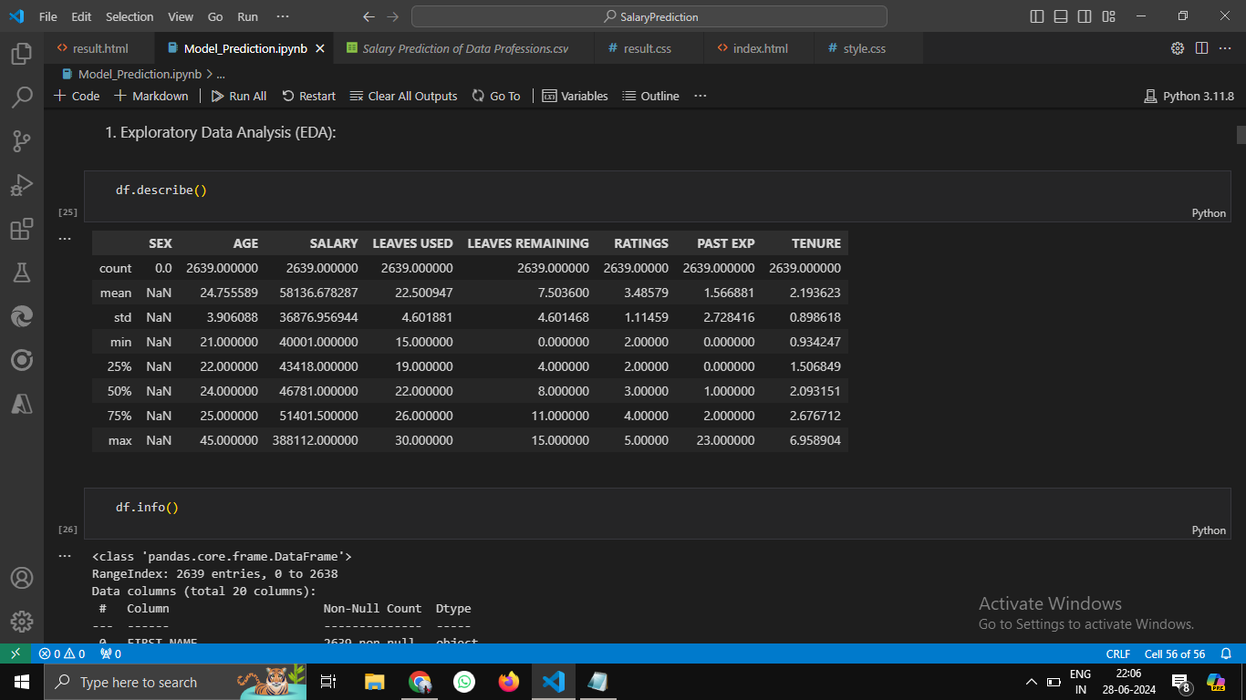
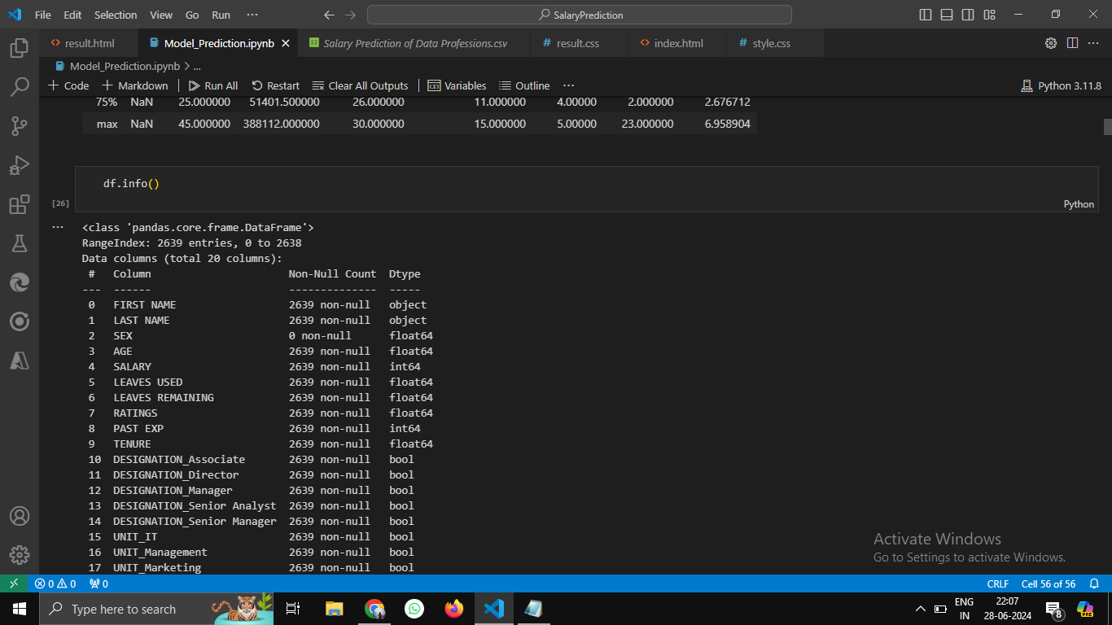

Slide 6
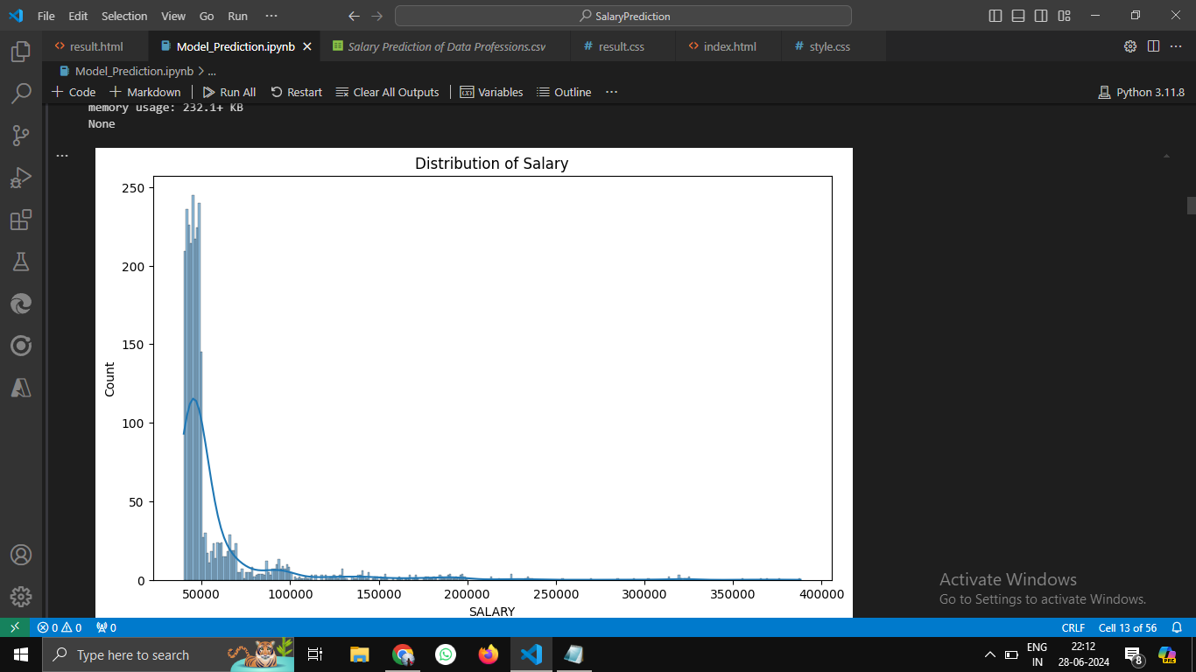
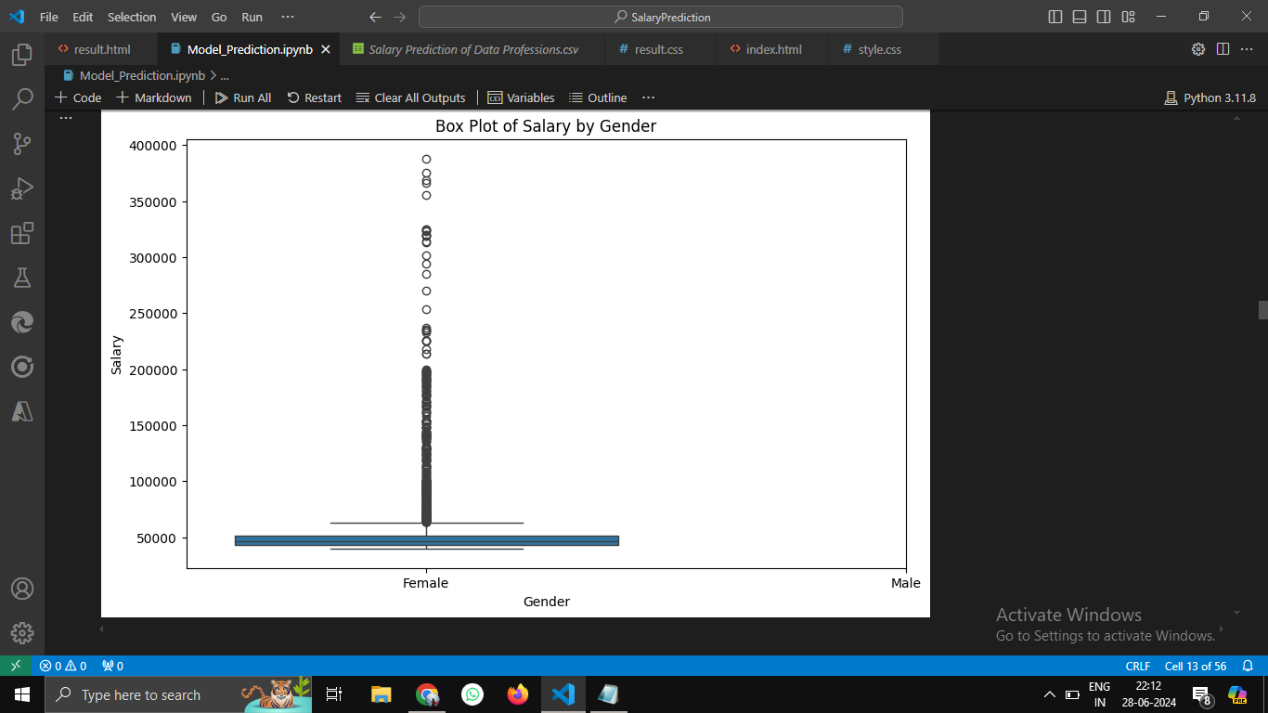

Slide 7
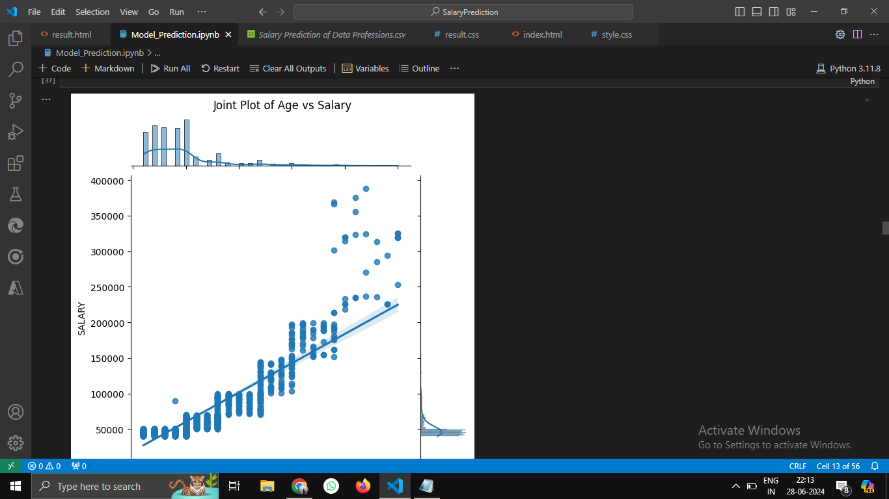
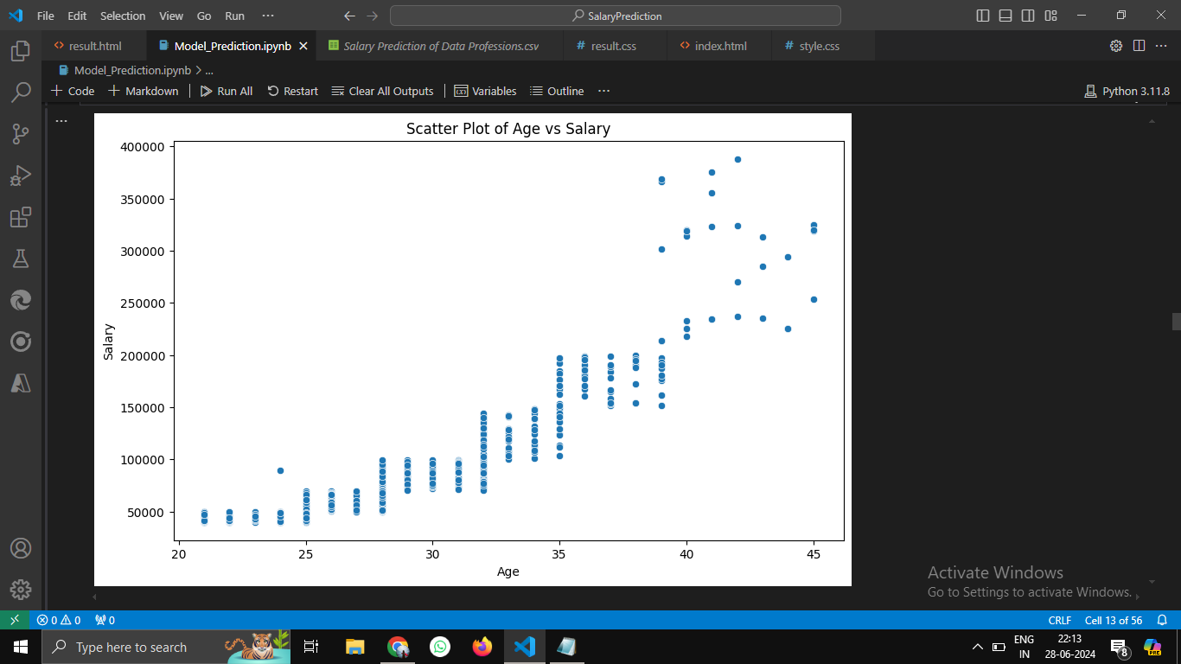

Slide 8
Feature Engineering: Enhancing Model Accuracy
Feature Derivation
1
We will create new features or transform existing ones based on our understanding of the data and the factors influencing salaries.
2
Experience-Based Features
Create features that capture the nuances of experience, such as years of experience in specific data roles, or years of experience with specific technologies. These can better reflect the impact of experience on salaries.
Job Role Features
3
Develop features that represent the complexity and responsibility of different job roles. For example, we could create a feature that indicates the seniority level of a data professional within their organization.
4
Performance Features
Engineer features that capture performance metrics, such as ratings or awards received, as these can significantly impact salary.

Slide 9

Data Preprocessing: Preparing for Model Training
Handling Missing Values
Encoding Categorical Variables
Scaling and Normalization
Impute missing values using appropriate techniques, such as mean imputation for numerical variables or mode imputation for categorical variables.
Convert categorical variables into numerical format using techniques like one-hot encoding or ordinal encoding. This allows machine learning models to process these features.
Scale or normalize features to ensure that they are on a similar scale. This prevents certain features from dominating others during model training.

Slide 10
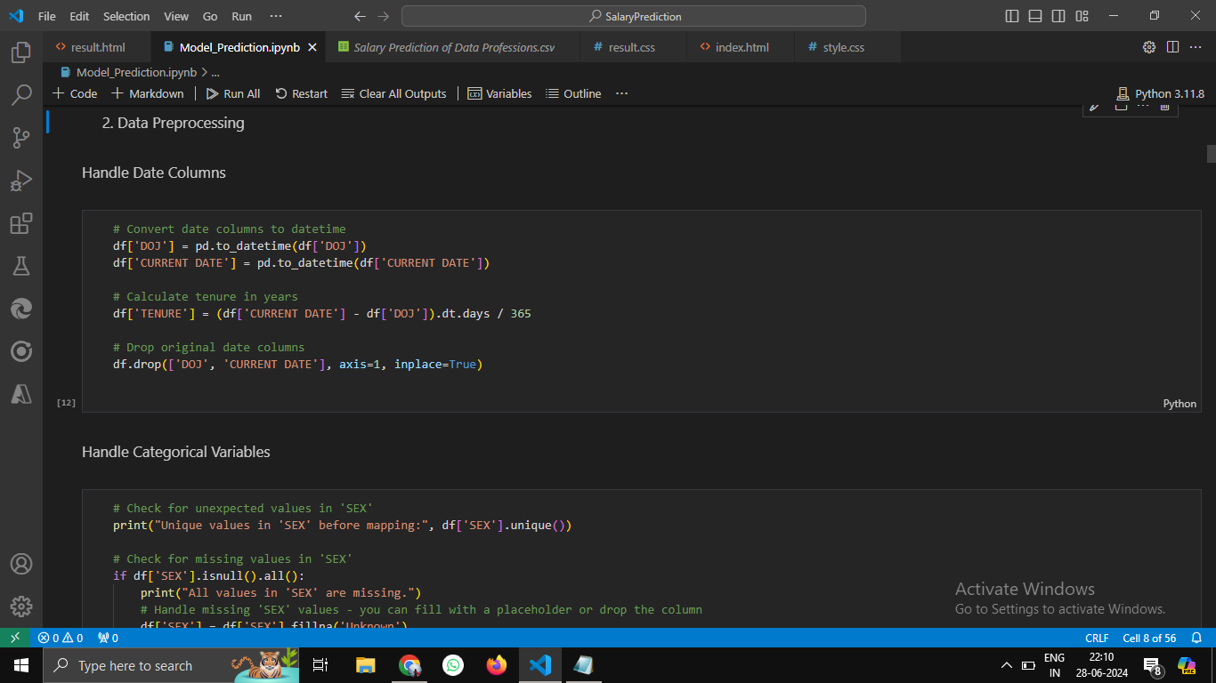
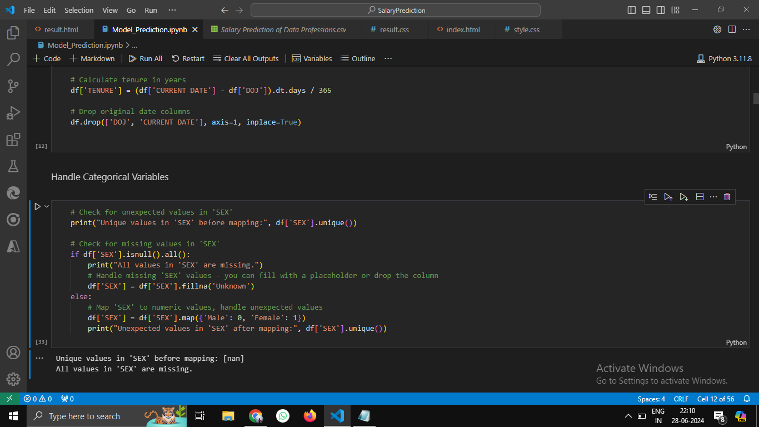

Slide 11
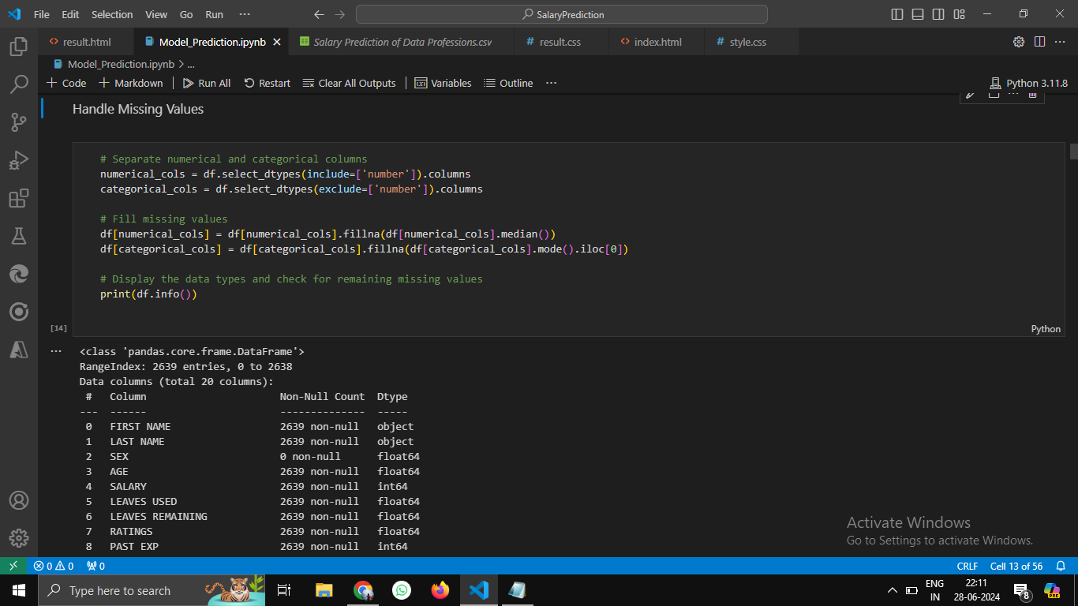

Slide 12





Machine Learning Model Development: Predicting Salaries
Regression Models
We will train various machine learning regression models to predict salaries.
Linear Regression
A simple yet powerful model that assumes a linear relationship between the input features and the target variable (salary).
Decision Trees
A tree-based model that creates a series of rules to predict salaries based on feature values.
Random Forests
An ensemble of decision trees that improves accuracy by averaging predictions from multiple trees.
Gradient Boosting
A powerful technique that combines multiple weak learners to create a strong predictor.

Slide 13
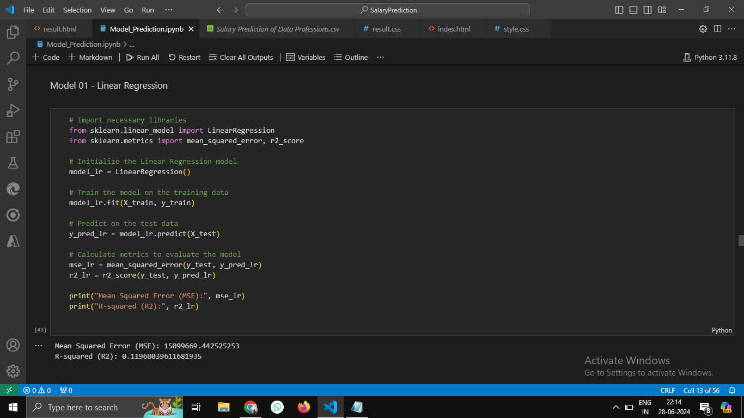
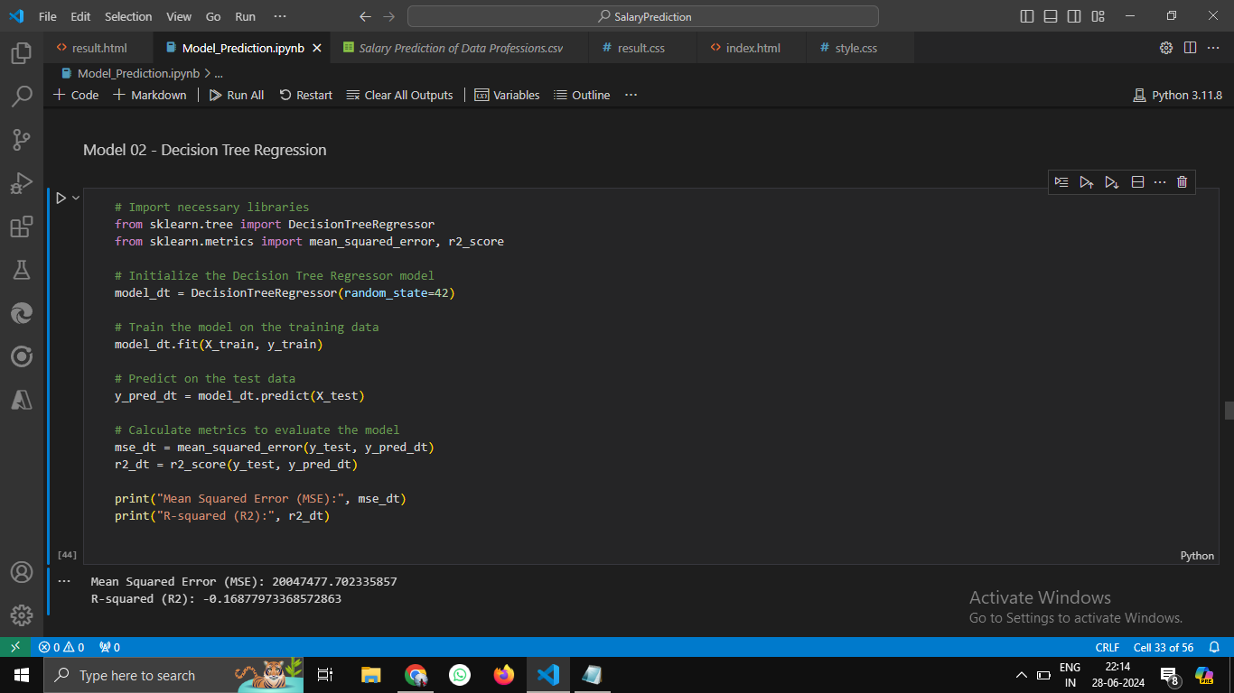

Slide 14
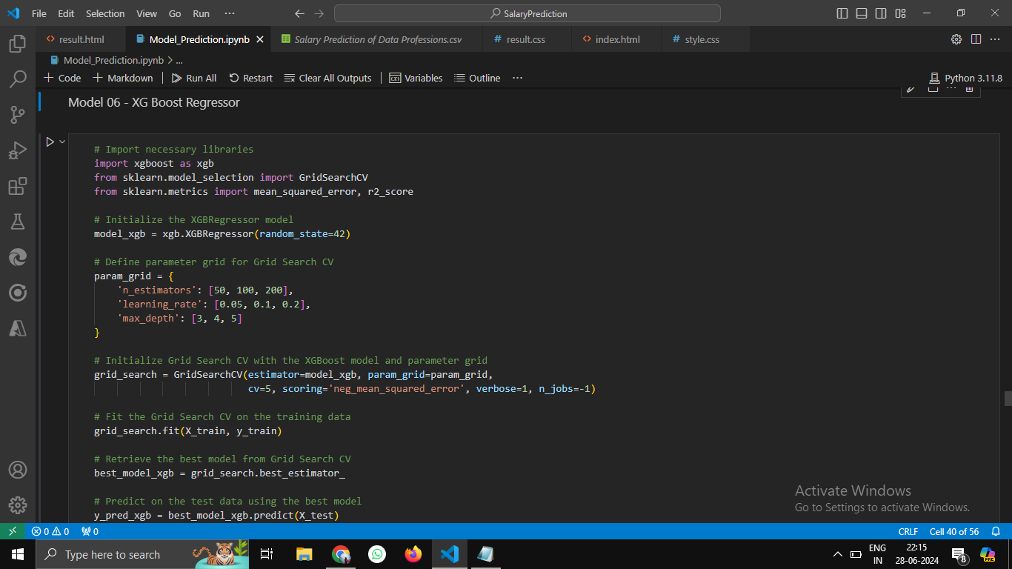
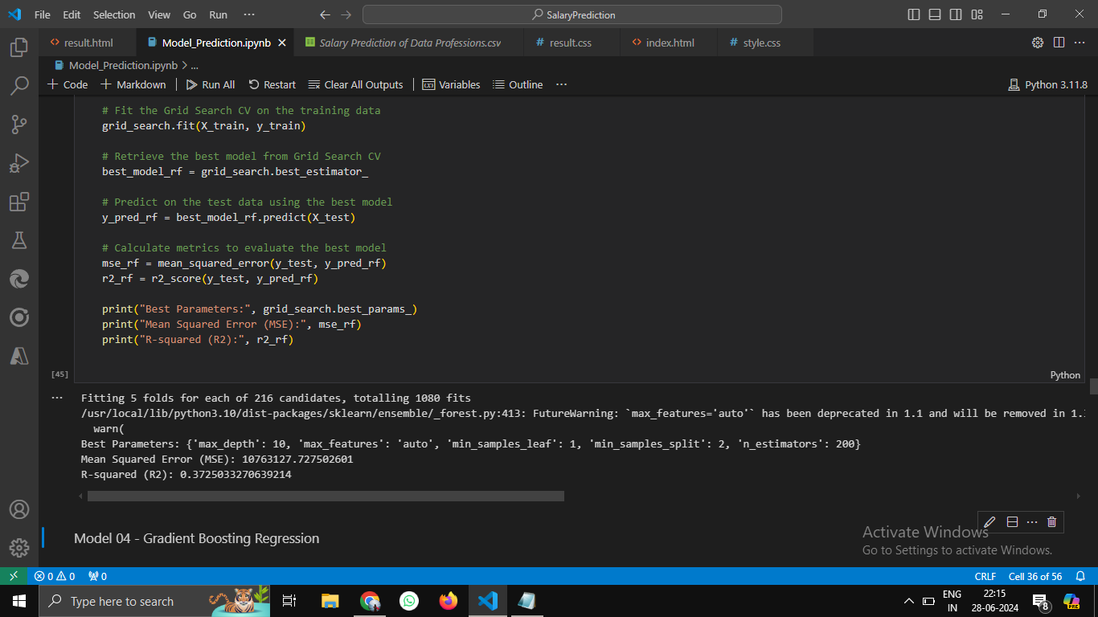

Slide 15
Model Evaluation: Assessing Performance
Metric
Description
Mean Absolute Error (MAE)
Average absolute difference between predicted and actual salaries.
Mean Squared Error (MSE)
Average squared difference between predicted and actual salaries.
Root Mean Squared Error (RMSE)
Square root of the MSE, providing a measure in the same units as the target variable.
R-squared (R2) Score
Indicates the proportion of variance in the target variable explained by the model.

Slide 16
Model Selection
Based on the model performance metrics, XGBoost stands out as the preferred model for your salary prediction project. Here is an elaboration on why XGBoost is a superior choice compared to other models:
Model Performance Comparison
Linear Regression:
Mean Squared Error (MSE): 15,099,669.44
R-squared: 0.1197
Lasso Regression:
MSE: 15,090,354.40
R-squared: 0.1202
Decision Tree:
MSE: 13,737,572.09
R-squared: 0.1991
Random Forest:
MSE: 11,452,558.97
R-squared: 0.3323
Gradient Boosting:
MSE: 11,417,003.19
R-squared: 0.3344
AdaBoost:
MSE: 11,579,201.82
R-squared: 0.3249
XGBoost:
MSE: 11,031,398.58
R-squared: 0.3569

Slide 17
Model Selection
Explanation
1. Higher Predictive Accuracy
XGBoost achieved the lowest MSE of 11,031,398.58, indicating that the average squared difference between the predicted and actual salaries is lower compared to other models. This demonstrates that XGBoost has a higher predictive accuracy, making its predictions closer to the actual salaries.
2. Better Model Fit
With an R-squared value of 0.3569, XGBoost explains approximately 35.69% of the variance in the salary data, which is higher than the other models. This means XGBoost captures more of the underlying patterns and relationships in the data, providing a better fit.
3. Handling Complexity
XGBoost excels in handling complex datasets with numerous features and interactions between them. Its boosting algorithm combines multiple weak learners (decision trees) to create a strong learner, effectively improving the model's accuracy and robustness.
4. Feature Importance
XGBoost provides built-in feature importance metrics, helping identify which features are most influential in predicting salaries. This insight can be valuable for further refining the model and understanding the factors affecting salary.
5. Regularization Techniques
XGBoost incorporates regularization techniques to prevent overfitting, which is crucial for achieving a balance between bias and variance. This ensures the model generalizes well to new, unseen data, maintaining its predictive power.

Slide 18



ML Pipelines and Model Deployment: Streamlining and Sharing Your Work
ML Pipelines
Model Deployment
User-Friendly Interface
Create ML Pipelines to automate the entire process, from data preprocessing to model training and evaluation. This ensures consistency and efficiency.
Deploy your best-performing model using frameworks like Flask or FastAPI. This allows you to share your model and generate predictions for unseen data.
Consider creating a user interface that allows users to input data and receive salary predictions. This makes your model accessible and user-friendly.

Slide 19
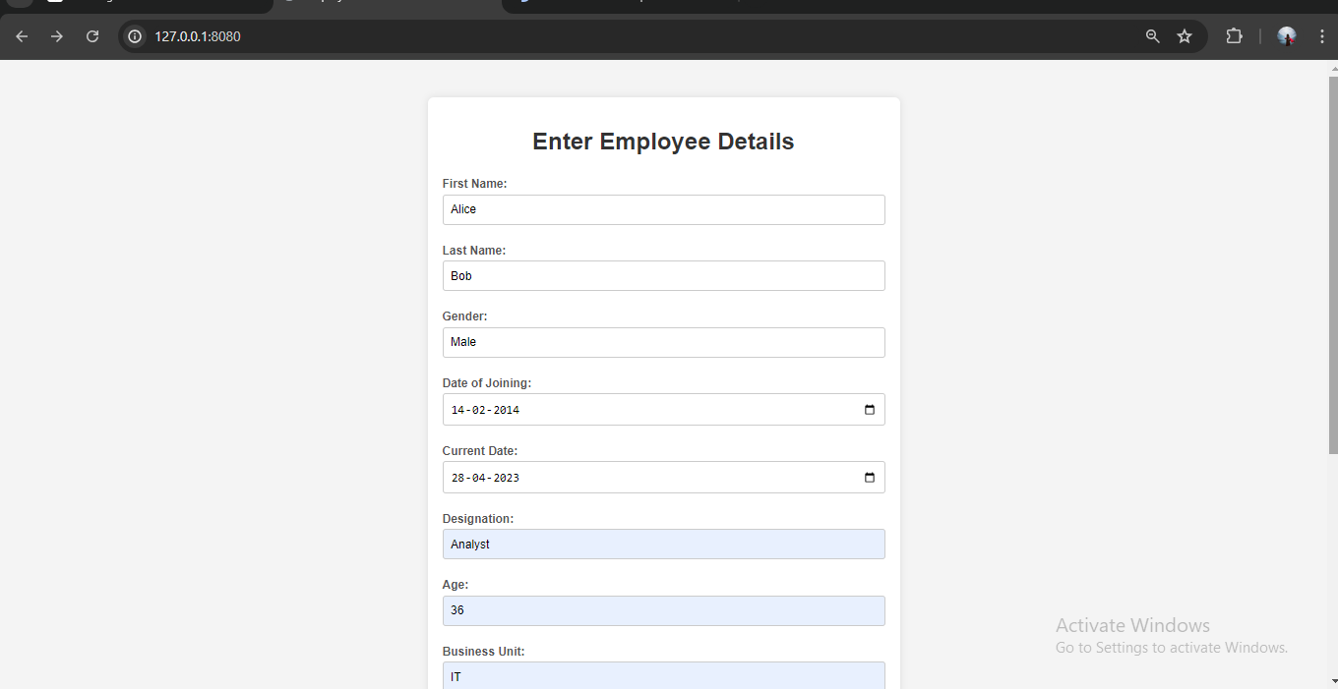
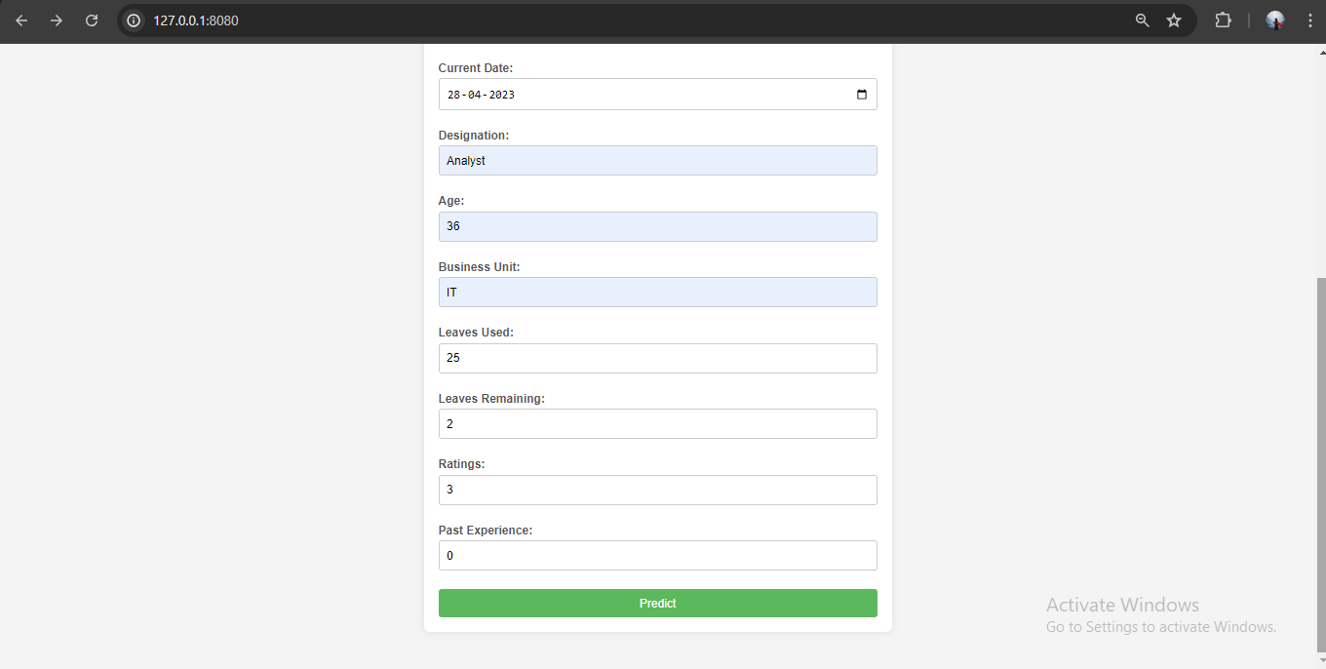

Slide 20
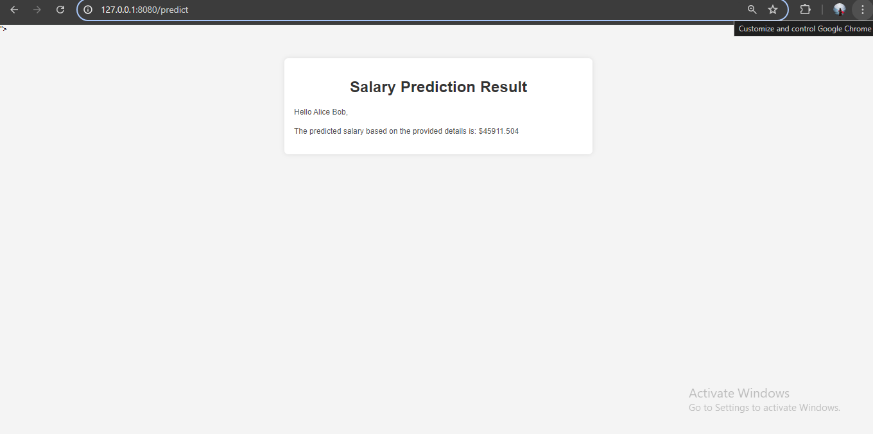

Slide 21
Recommendations: Actionable Insights for Data Professionals
1
Salary Factors
2
Skill Development
Based on the model's insights, provide recommendations on the key factors influencing salaries, such as experience level, job role, performance, and location.
Highlight skills that are highly valued in the data profession and that can lead to higher salaries. Recommend relevant courses or certifications.
3
Career Advancement
4
Negotiation Strategies
Provide guidance on career paths and strategies for advancing within the data profession to achieve higher earning potential.
Offer insights on how to effectively negotiate salaries based on the model's predictions and industry trends.

Slide 22
Conclusion: Empowering Data Professionals and Employers
This project empowers data professionals by providing insights into salary trends and actionable recommendations for career growth. For employers, the model provides a tool for making informed hiring decisions and setting competitive salaries. By leveraging machine learning and data analysis, you will gain a deeper understanding of the factors influencing salaries in the dynamic field of data professions.

